Slide 1


Slide 2
Molecular Imaging in Neuroendocrine Differentiation
of Prostate Cancer
GhasemAli Divband, MD, IBNM 13 Nov. 2020

Slide 3
Treatment-emergent Neuroendocrine Prostate Cancer (t-NEPC)
Neuroendocrine Prostate Cancer may arise de novo, but the large majority of cases occur in patients with CRPC that have been treated with hormonal therapy and/or taxane-based chemotherapy. Clinically, t-NEPC is an extremely aggressive malignancy that is resistant to current therapies used in the context of advanced prostate adenocarcinoma.
In addition, t-NEPC displays high proliferative rates and tumor dissemination can occur quite rapidly. Unlike CRPC, which tends to produce osseous metastases, t-NEPC typically disseminates to visceral organs such as lung and liver.

Slide 4
The IHC profile of t-NEPC includes the expression of neuroendocrine markers such as (SYP), (CHGA) and (NSE), as well as absent AR and PSA expression. Once considered a very rare occurrence, t-NEPC has become an increasingly recognized clinical problem. Recent evidence indicates that approximately one out of six patients with progressive hormone-resistant PCa has NEPC. In keeping with this evidence, autopsy studies have shown that neuroendocrine foci may be present in about 10–20% of CRPC patients. Given the extensive targeting of AR pathway and testosterone metabolism by recently developed drugs, the incidence of t-NEPC is expected to rise significantly in the near future. Unfortunately, t-NEPC is currently difficult to diagnose because it often arises in patients with multiple metastases, a condition that usually discourages clinicians from performing biopsies. As a result, the incidence of t-NEPC is usually underestimated and patients with undiagnosed t-NEPC are treated unnecessarily with the same regimen as patients with AR-positive prostate adenocarcinoma, with no success.

Slide 5
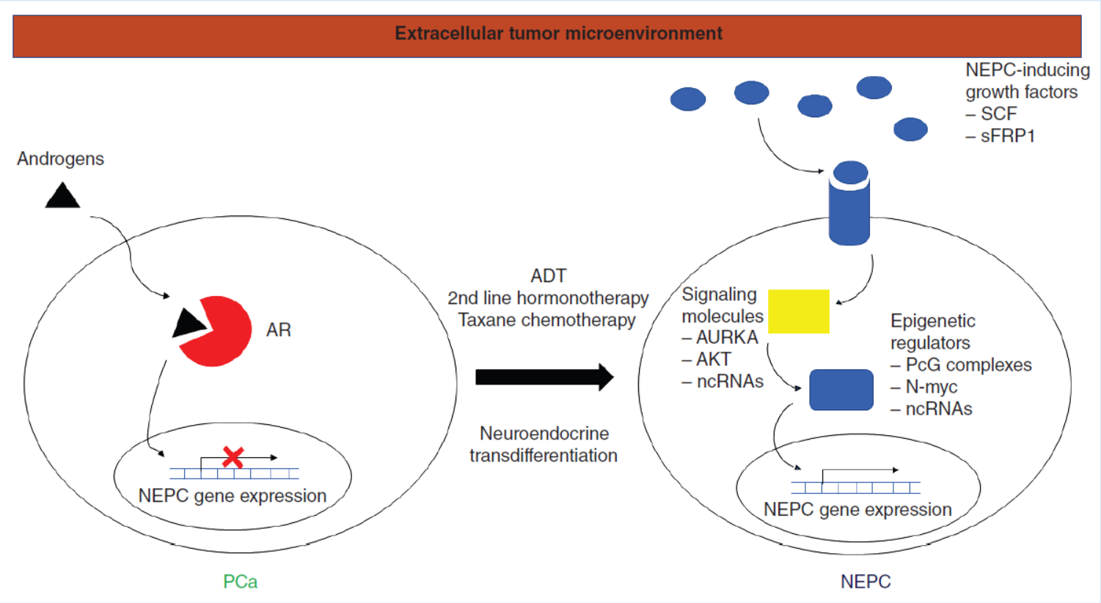
Molecular mechanisms involved in neuroendocrine prostate cancer pathogenesis

Slide 6
Screening & diagnosis
Imaging
Serum markers
Biopsy of metastatic tissues
In particular, rapidly progressing lesions without a proportional PSA rise, in patients exposed to hormonal therapies should prompt BX. BX should also be considered in CRPC patients with visceral metastases or NEPC-associated paraneoplastic syndromes.
Finally, clinicians should consider BX in the context of elevated serum markers such as CHGA and NSE.

Slide 7
Molecular Imaging in Neuroendocrine Differentiation
of Prostate Cancer
⁶⁸Ga-PSMA PET/CT
¹⁸F-FDG PET/CT
⁶⁸Ga-SSTR PET/CT (DOTATATE, DOTANOC, DOTATAOC)

Slide 8
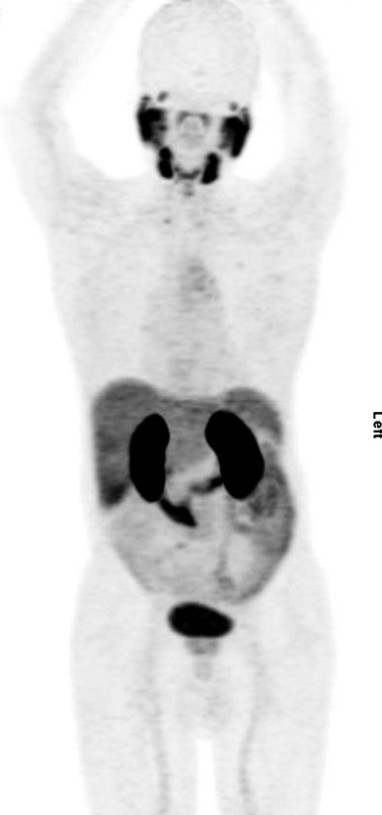
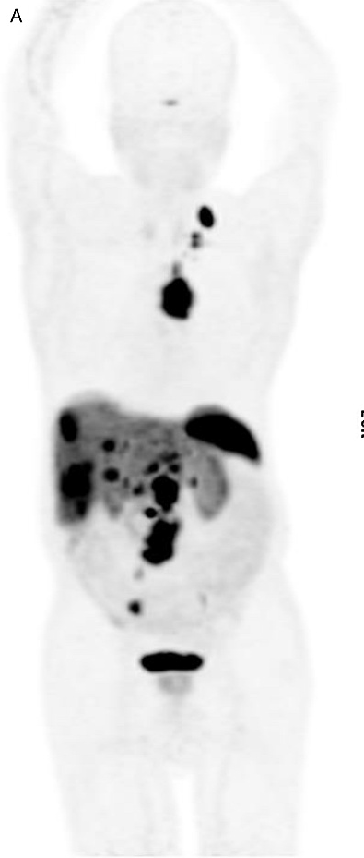
⁶⁸Ga-PSMA PET
⁶⁸Ga-DOTANOC PET

Slide 9
⁶⁸Ga-PSMA PET
⁶⁸Ga-DOTA PET
¹⁸F-FDG PET

Slide 10
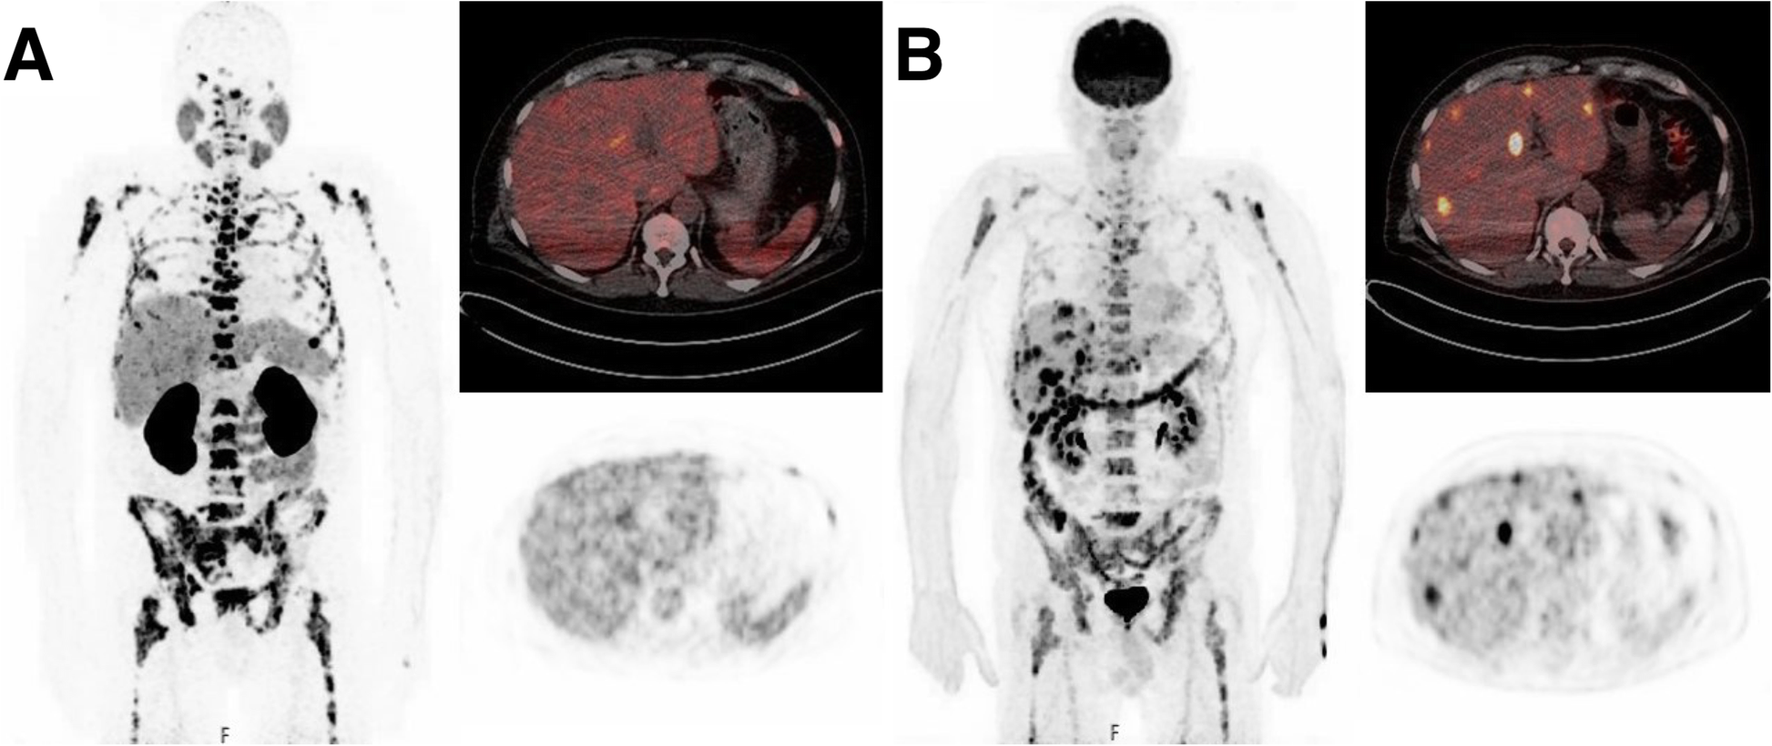
⁶⁸Ga-PSMA PET
¹⁸F-FDG PET
PRRT issues

Slide 11
Future perspective & research topics for t-NEPC
Appropriate diagnostic algorithm
Efficient prevention
Effective therapy

Slide 12

We all hope we can cure all cancers one day …

